Slide 1

Multi Disease Prediction System using Machine Learning Models

Slide 2


Hello!
This is Group-6
The team includes:
Saketh Kanchi: 221910320033
Ayman Saami: 221910320018
Swaroopa: 221910320028
References: Multi Disease Prediction System using Random Forest Algorithm in Healthcare System

Slide 3
Disease, sickness, and old age touch every family. Tragedy doesn't ask who you voted for. Health care is a basic human right.

Slide 4


Motivation

Slide 5
What motivated us
Less Availability of Health Centre
Less Availability of doctors
Recognize the disease from symptoms
Distance of health centre

Slide 6
Objectives

Slide 7
What we aim to achieve?
Our main aim is to provide a quick medical diagnosis to the patients living in places where doctors are scarce.
The goal is to provide access to medical specialists
This system enhances quality of health care

Slide 8
Introduction
Machine learning is a subfield of artificial intelligence. The goal of machine learning is to understand the structure of data and fit that data into models that can be understood and utilized by people
Machine learning is used in Medical diagnosis, Stock market trading, Image recognition and more.

Slide 9
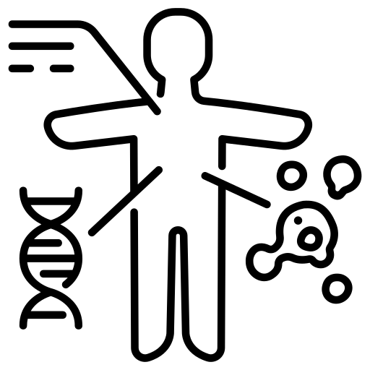
Workflow

Slide 10
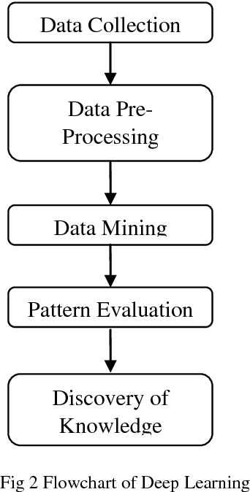
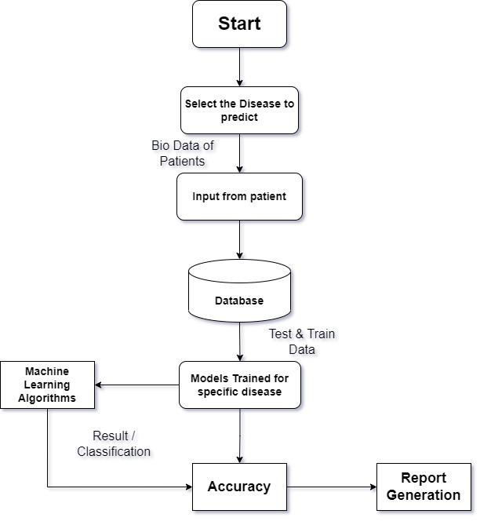

Slide 11
Machine Learning and Algorithms
Machine learning algorithms can be divided into three categories according to their purposes. They are:
Supervised
Unsupervised
Semi-supervised
For disease prediction the learning model include Linear Regression, Support Vector Machine, Decision Tree, Random Forest, Naïve Bayes, K-nearest neighbour, Artificial Neural Network.

Slide 12
Best Optimized Algorithms
Algorithm | Disease Name
SVM | Diabetes, Breast Cancer, Parkinson's
RF | Breast Cancer, Diabetes, Heart Disease
DT | Breast Cancer, Cerebral infarction, Kidney disease
NB | Asthma, Heart Disease, Prostate Cancer
ANN | Breast Cancer, Heart Disease, Stroke
KNN | Heart Disease, Parkinson's Disease
LR | Heart Disease, Liver Disease

Slide 13
Disease Predictions
Diabetes
Heart Disease
Parkinson's

Slide 14
End of Review 0

Slide 15
Input Parameters for Diabetes
Pregnancies: Number of times pregnant
Glucose: Plasma glucose concentration a 2 hours in an oral glucose tolerance test
BloodPressure: Diastolic blood pressure (mm Hg)
SkinThickness: Triceps skin fold thickness (mm)
Insulin: 2-Hour serum insulin (mu U/ml)
BMI: Body mass index (weight in kg/(height in m)^2)
DiabetesPedigreeFunction: Diabetes pedigree function
Age: Age (years)

Slide 16
Input Parameters for Heart Disease
Age: age of the patient [years]
Sex: sex of the patient [M: Male, F: Female]
ChestPainType: chest pain type [TA: Typical Angina, ATA: Atypical Angina, NAP: Non-Anginal Pain, ASY: Asymptomatic]
RestingBP: resting blood pressure [mm Hg]
Cholesterol: serum cholesterol [mm/dl]
FastingBS: fasting blood sugar [1: if FastingBS > 120 mg/dl, 0: otherwise]
RestingECG: resting electrocardiogram results [Normal: Normal, ST: having ST-T wave abnormality (T wave inversions and/or ST elevation or depression of > 0.05 mV), LVH: showing probable or definite left ventricular hypertrophy by Estes' criteria]
MaxHR: maximum heart rate achieved [Numeric value between 60 and 202]
ExerciseAngina: exercise-induced angina [Y: Yes, N: No]
Oldpeak: oldpeak = ST [Numeric value measured in depression]
ST_Slope: the slope of the peak exercise ST segment [Up: upsloping, Flat: flat, Down: downsloping]

Slide 17
Input Parameters for Parkinson's Disease
name - ASCII subject name and recording number
MDVP:Fo(Hz) - Average vocal fundamental frequency
MDVP:Fhi(Hz) - Maximum vocal fundamental frequency
MDVP:Flo(Hz) - Minimum vocal fundamental frequency
MDVP:Jitter(%), MDVP:Jitter(Abs), MDVP:RAP, MDVP:PPQ, Jitter:DDP - Several measures of variation in fundamental frequency
MDVP:Shimmer,MDVP:Shimmer(dB),Shimmer:APQ3,Shimmer:APQ5,MDVP:APQ,Shimmer:DDA - Several measures of variation in amplitude
NHR, HNR - Two measures of the ratio of noise to tonal components in the voice
status - The health status of the subject (one) - Parkinson's, (zero) - healthy
RPDE, D2 - Two nonlinear dynamical complexity measures
DFA - Signal fractal scaling exponent
spread1,spread2,PPE - Three nonlinear measures of fundamental frequency variation

Slide 18
Random Forest Classification
Random Forest is a classifier that contains a number of decision trees on various subsets of the given dataset and takes the average to improve the predictive accuracy of that dataset
The greater number of trees in the forest leads to higher accuracy and prevents the problem of overfitting.

Slide 19
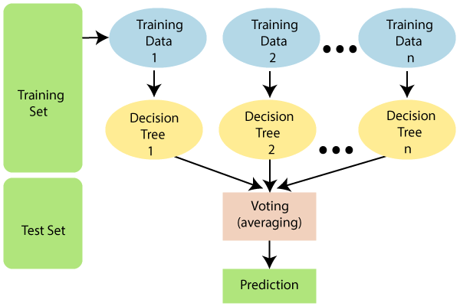

Slide 20
Why use Random Forest?
It takes less training time as compared to other algorithms.
It predicts output with high accuracy, even for the large dataset it runs efficiently.
It can also maintain accuracy when a large proportion of data is missing.

Slide 21
Advantages of Random Forest
Random Forest is capable of performing both Classification and Regression tasks.
It is capable of handling large datasets with high dimensionality.
It enhances the accuracy of the model and prevents the overfitting issue.

Slide 22
Performance Analysis of Diabetes Prediction Model
Algorithms | Accuracy | Time of execution | R-Squared | Precision | Recall | F1-Score
RFA | 92.3 | 0.37 | 0.64 | 94 | 91 | 92
SVM | 79.75 | 0.127 | 0.08 | 78 | 76 | 76
LR | 79 | 0.048 | 0.047 | 76 | 74 | 75
KNN | 80.5 | 0.134 | -1.19 | 46 | 46 | 46
NB | 79 | 0.019 | 0.046 | 77 | 76 | 77
AB | 82 | 0.61 | 0.182 | 80 | 80 | 80
DT | 80 | 0.012 | -0.046 | 75 | 69 | 72

Slide 23



Softwares Used
Backend:
Python
Anaconda
Frontend:
Streamlit

Slide 24
Thanks!
Any questions ?
You can find us at
group-6@mail.me

